Slide 1

Vehicle Number plate Detection (VNPD)
-by:
Varshitha Reddy
Shahriar Bulbul
Rudraksh Sugandhi
Syam Siva Kumar Badri

Slide 2
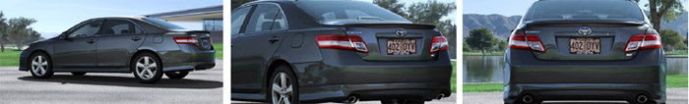
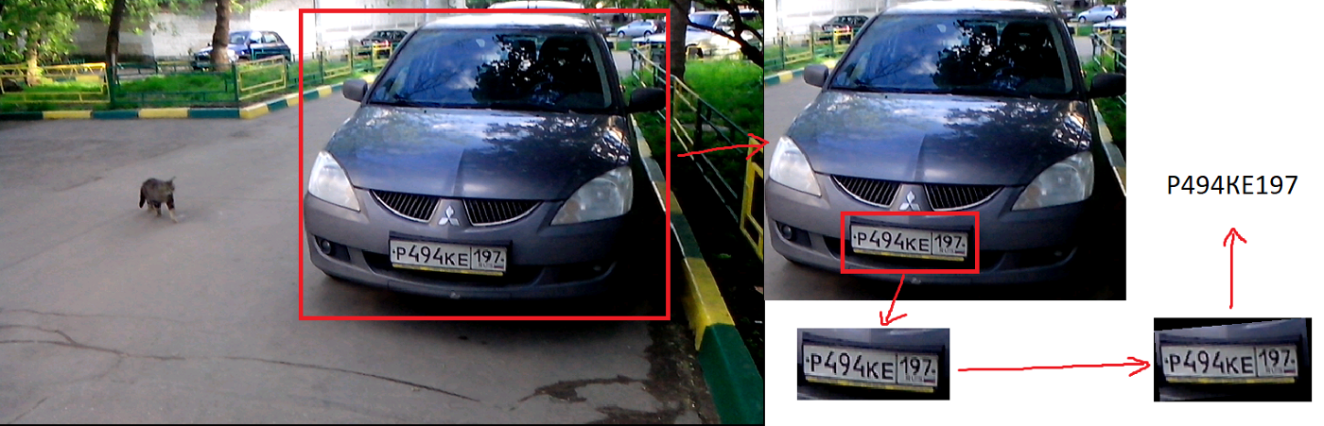
Must-have requirement
Vehicle area search: the user must detect bounding boxes on the vehicle.
Plate orientation recognition: the user must be able to detect license plate irrespective of abnormalities like inverted images, etc.

Slide 3

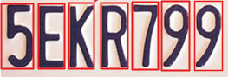
Normalization: The user must be able to control the brightness and contrast of the image of the license plate that was captured.
Optical character recognition (OCR) or character Segmentation:

Slide 4
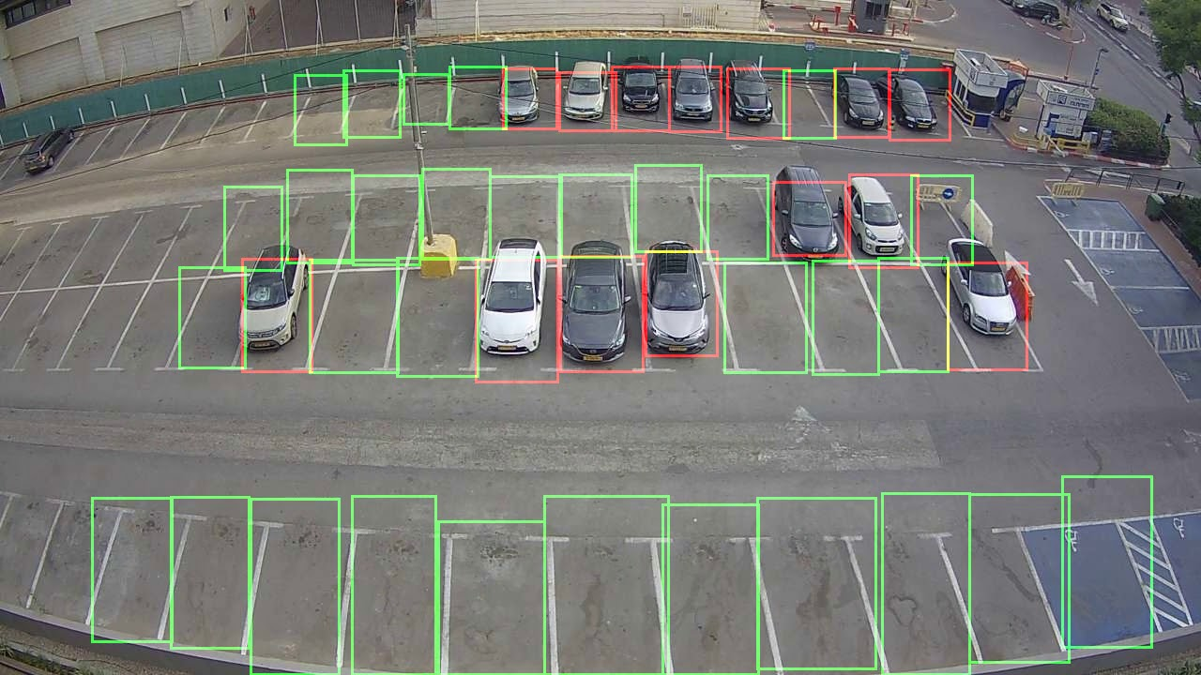
Lane detection for Reserved parking :

Slide 5
User: University Police Department (UPD)
Must have features:
The user must be able to recognize the car.
The user must be able to detect the license plate irrespective of abnormalities like images captured in abnormal angles, etc.
The user must be able to detect a car that is not parked in between the striping.
The user must be able to detect a car that is parked in fire lanes
The user must be able to detect a car that is parked in reserved lanes.
The user must be able to detect and identify number plates on low resolution captures.
Could have features:
The user could detect the location of a vehicle based on the number plate inf fed to the system.
The user could generate fine charges and warnings to the owner of the vehicle if there's any abnormal parking detected.
The user could get the count of all the vehicles in the particular parking lot.

Slide 6
Nice-to-have Requirement
Car counting System
Vehicle Recognition
Vehicle Localization
User email address based on number plate
Automatic fine for wrong parking

Slide 7
Functional Requirement
FQ-1 | The system must be able to recognize the car.
FQ-2 | The system must be able to locate Number plate
FQ -3 | Convert the image into the text number plate(OCR)
FQ-4 | The system must be working in a real time which allows the users to view 24/7

Slide 8
Non-Functional Requirement
3 The system shall have an ability to mark detected vehicle
NFQ-1 | The system shall be able to support various operation systems such as Linux and Windows.
NFQ-2 | The system shall be able to be extended in the future.
NFQ -3 | The system shall be able to be maintainable.
NFQ-4 | Design a secured system that prevents data-breach.

Slide 9
Thank you

